Slide 1
Impact on Team Performance of Top 5 League's Teams Due to Increase in Number of Matches
SE7009 Applying Research Skills Sarvesh Dalvi u2781237

Slide 2
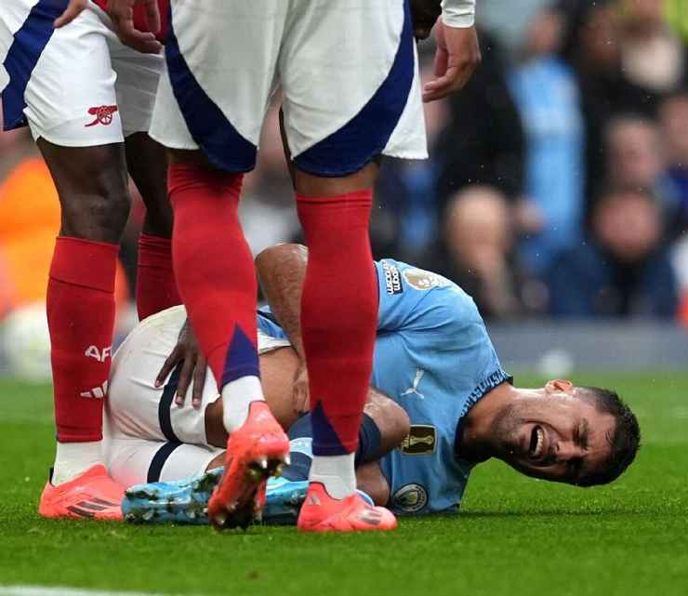
Introduction
Top clubs in top 5 leagues in Europe compete in European tournaments (UCL & Europa) along with the domestic league and cups.
European teams are facing more congested fixtures over the past decade, particularly when they participate in these leagues mid-week (Buchheit & Settembre, 2024).
Impact on Teams:
Match congestion puts stress on teams to maintain high standards of play under tight timeframes.
Faces the challenge of balancing their best players across high-stakes games.
Small teams with lighter schedule might benefit from better recovery.
More revenue.
Rodri ACL injury(Ogden, 2024)

Slide 3
Introduction
Why it matters?
Teams with denser fixtures might underperform compared to their quality, Influencing league Ranking.
With European leagues being the most viewed globally, understanding this issue is essential for maintaining the quality of football.
Goals of the study:
To explore how match congestion impacts team performance metrics 1 Goals per match 2 Possession 3 Defensive stability
To assess difference between teams with dense fixtures and teams with lighter schedule.

Slide 4
Literature review
Dellal et al. (2013) highlighted the negative impact of fixture congestion on physical and technical performance during matches.
Studied High-intensity action (e.g., sprinting)
Study also suggested lack of recovery time leads to high chance of injury.
Anderson et al. (2015) studied the training load and performance impact when teams play multiple games within a week.
Experimental design analyzing the relationship between training loads and match schedules in the EPL.
Found that recovery times of less than 72 hours decreased both offensive (goals per match) and defensive (clean sheets) metrics.
Morgan et al. (2014) reported that teams with higher density match saw reduced possession rates and drops in defensive interception.

Slide 5
Literature review
Jones et al. (2020) observed that teams with fewer squad rotations during congested periods performed worse in both UEFA and domestic competitions.
Fixture congestion negatively impact goals scored and clean sheets.
Used regression analysis of match outcomes.
McCall et al. (2019) observed that effective workload management and squad rotation strategies reduce performance dips and injury rates.
Analyzed injury occurrences and prevention strategies in teams competing in European competition.
Variables used for team success were points per match and GD.
Carling et al. (2015) did a quantitative analysis comparing high-intensity running and technical metrics during normal and congested periods.
Key finding was congestion reduces the running, passing and possession retention.

Slide 6
Literature review
Carling et al. (2016) study indicates that teams that regularly participate in multiple competition develop greater tactical flexibility.
Increased match exposure can enhance players’ match fitness and mental resilience, allowing them to perform better during high-pressure matches in critical stages of the season.
Krustrup, P., & Mohr, M. (2014) studied importance of match exposure in football.
Suggested Players involved in regular, high-intensity matches tend to have better physiological adaptation to the demands of professional level.
Squad rotation in dense fixture schedules encourages player development.
Sampaio, J., & Maçãs, V. (2012) suggests that competitive match congestion can strengthen team cohesion.
Playing more frequently together helps teams develop a better understanding and communication, improving overall tactical execution on the field.

Slide 7

Research design
Scope:
Analyze team performance across the top 5 leagues (2013–2023).
Include UEFA and international fixtures for "big teams."
Focus Area:
Goals per match, xG, passing accuracy, possession, defensive metrics (e.g., clean sheets, tackles).

Slide 8
Research method
Samples: - Teams from EPL, La Liga, Bundesliga, Serie A, Ligue 1. - Divide into two groups: 1. High-density teams (UEFA and international matches). 2. Low-density teams (domestic-only schedules).
Data Sources: - Match stats: OPTA, FBref. - Fixture density: UEFA and league calendars. - Team metrics: Transfermarkt, team websites.
Variables: - Independent Variable: Match density (e.g., matches played within 10 days). - Dependent Variables: Goals per match, xG, possession, passing accuracy, clean sheets, points per match.

Slide 9
Data analysis
Techniques - Regression Analysis: Correlate match density with performance metrics. Example: Does increased match density reduce goals scored or clean sheets? - Comparative Analysis: Compare high-density vs. low-density team’s metrics (goals, clean sheet). - Visualization Tools: Line graphs showing team performance trends over seasons. Comparative bar charts for high-density vs. low-density teams.
Software - Python and Tableau.

Slide 10
Anticipated challenges
Data Limitations: - Injury and squad rotation data may be incomplete or inconsistent, particularly for earlier seasons (2013–2015).
Confounding Variables: - Differences in tactical approaches, team budgets, and squad depths may affect performance metrics independent of match density.
Variability in Teams: - Team strength and squad depth differ across leagues, making comparisons challenging.

Slide 11
Anticipated challenges
Mitigation Strategies: - Focus on post-2015 data for more robust and consistent information. - Normalize performance metrics by considering squad strength (e.g., market value, bench depth). - Use comparative methods across multiple seasons to identify consistent trends and control variability.

Slide 12
Significance of the Study
Theoretical Contribution: - Provides a detailed understanding of how fixture congestion impacts team performance across multiple metrics. - Extends previous studies by comparing high-density and low-density teams over a 10-year period, offering robust insights.

Slide 13
Practical Applications
For League Organizers: - Recommendations for optimizing fixture schedules to minimize performance deterioration for teams competing in multiple tournaments.
For Coaches and Teams: - Insights into squad rotation and recovery strategies to mitigate performance drops during congested periods.
For Football Analysts: - Data-driven findings on which performance metrics are most affected by increased match loads, providing guidance for performance optimization.

Slide 14
references
Anderson, L., Orme, P., Di Michele, R., Close, G.L., Milsom, J., Morgans, R., Drust, B., and Morton, J.P. (2015). Quantification of training load during one-, two- and three-game week schedules in professional soccer players from the English Premier League: implications for carbohydrate periodisation. Journal of Sports Sciences, 34(13), pp.1250–1259. doi:10.1080/02640414.2015.1106574. Buchheit, M., & Settembre, M. (2024, February 16). Do mid-week European matches influence European teams’ performance in their domestic league? A 20-year study. Kitman Labs. https://www.kitmanlabs.com/blog/verheijen-20-year-study/ Carling, C., Le Gall, F., Dupont, G. (2015). Analysis of repeated high-intensity running performance in professional soccer. International Journal of Sports Physiology and Performance, 10(3), pp.333–339. doi:10.1123/ijspp.2014-0216.
Carling, C., Le Gall, F., Dupont, G., & Dufour, T. (2016). The influence of match congestion on team performance in professional soccer. Journal of Sports Sciences, 34(6), pp. 1057–1064. doi: 10.1080/02640414.2015.1115845. Dellal, A., Lago-Peñas, C., Rey, E., Chamari, K. and Orhant, E. (2013). The effects of a congested fixture period on physical performance, technical activity, and injury rate during matches in a professional soccer team. British Journal of Sports Medicine, 47(14), pp.743–748. doi:10.1136/bjsports-2012-091290. Jones, R.N., Greig, M., and Drust, B. (2020). Effects of short-term fixture congestion on performance and injury in elite soccer players. Scandinavian Journal of Medicine & Science in Sports, 30(3), pp.675–684. doi:10.1111/sms.13612.
Krustrup, P., & Mohr, M. (2014). The importance of match exposure in football. Scandinavian Journal of Medicine & Science in Sports, 24(2), pp. 228–237. doi: 10.1111/sms.12139. McCall, A., Dupont, G., and Ekstrand, J. (2019). Injury prevention strategies, coach compliance and team success in elite football: an international perspective. British Journal of Sports Medicine, 54(1), pp.9–19. doi:10.1136/bjsports-2018-099586.
Morgans, R., Orme, P., Anderson, L., Drust, B., and Morton, J.P. (2014). Principles and practices of training for soccer. Journal of Sports Sciences, 32(13), pp.1211–1218. doi:10.1080/02640414.2014.907995.

Slide 15
references
Ogden, M. (2024, September 23). Rodri’s injury just made Man City’s task so much harder - ESPN. ESPN.com. https://www.espn.co.uk/football/story/_/id/41400885/rodri-injury-manchester-city-premier-league-pep-Guardiola
Sampaio, J., & Maçãs, V. (2012). The effect of match congestion on the performance of top-level soccer teams. International Journal of Performance Analysis in Sport, 12(1), pp. 82–93. doi: 10.1080/24748668.2012.11868669.

